Slide 1
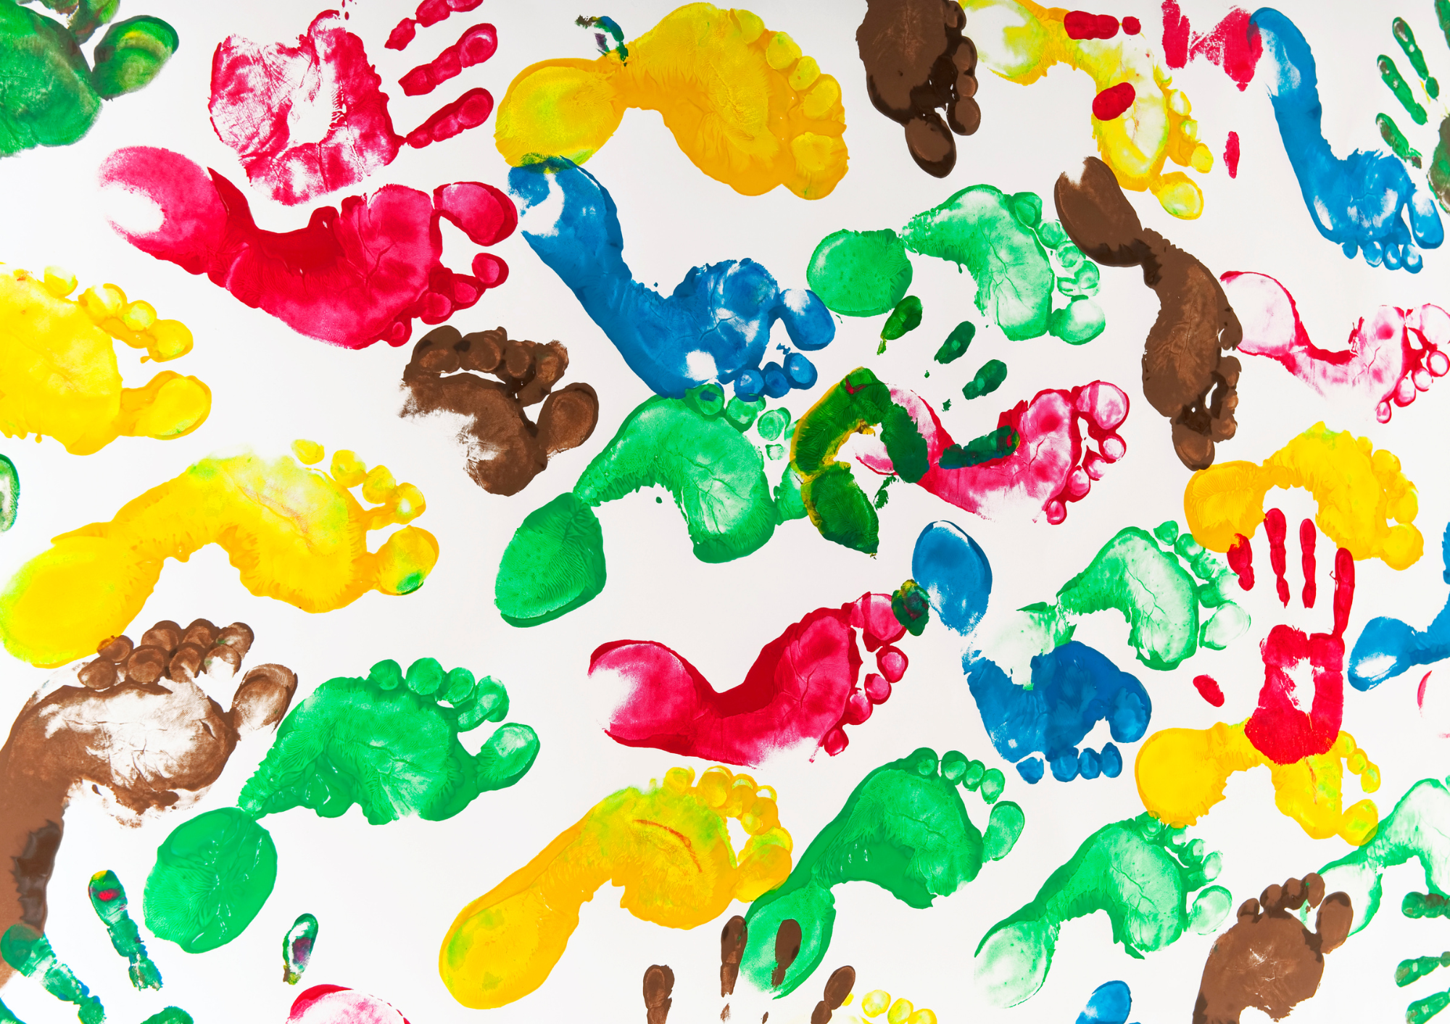




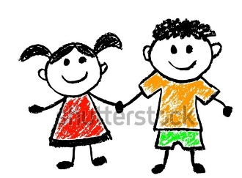
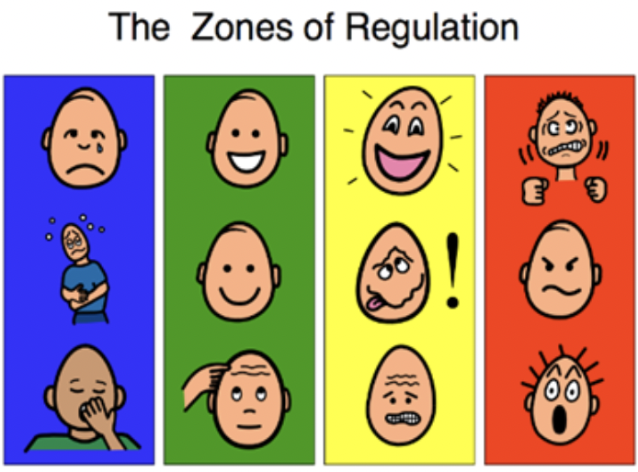
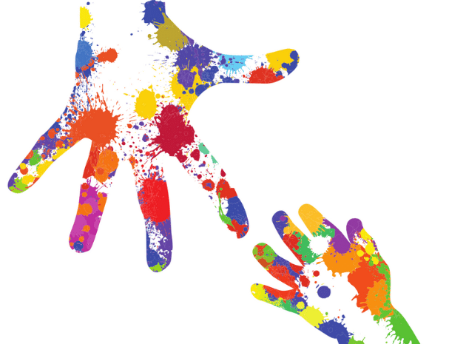



All about me & my family - Knowledge Organiser – Year 1/Reception //Nursery Aut Term 1
Links to Other Subjects
Art: Self Portrait PD: Develop fine and gross motor skills, develop the skills they need to manage the school day successfully (lining up, mealtimes, personal hygiene)
Key Vocabulary
Friends: a person who you know well and who you like a lot.
Siblings: a sister or a brother
Pets: animals that live in your home
Feelings: something that you feel
Emotions: how you react to a feeling
Zones of Regulation: the different ways you can feel
Similarities: things that are the same
Difference: things that are different
Key Knowledge
Talk about members of their immediate family and community. Name and describe familiar people. Describe what they see, hear and feel. Express their feelings and consider the feelings of others. Think about the perspectives of others Manage own needs. Build constructive and respectful relationships. Show resilience and perseverance in the face of challenge. Use new vocabulary, e.g. adjectives to describe themselves and others. Use longer sentences
Prior Learning | Preparing for the Future
Developed a sense of responsibility and membership of a community. Become more outgoing with unfamiliar people in a safe context. Develop friendships with other children Notice and ask questions about differences between people. Make connections between the features of their family and other families. | Work and play cooperatively and take turns with others. Show sensitivity to own and others needs. Set and work towards simple goals. Safely use a variety of materials, tools and techniques. Talk about the lives of people around them and their roles in society.

