Slide 1
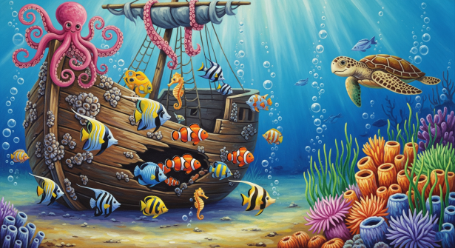


Under the Sea - Knowledge Organiser – EYFS Term 6
Links to Other Subjects
UTW: Learn about physical features of the sea. Learn about animals who live in the sea. Learn how we can protect the sea (environment and animals) EAD: Use junk-modelling, paint, wax resist, and clay to create their own seaside/animals art and craft Sing seaside themed songs Maths: Patterns, shapes, time, introduction to money Literacy: Reading and writing rlated to the sea.
Key Knowledge
Encourage careful observational drawings of the natural world using photographs and stories While researching the seaside, encourage recognising and naming the different creatures and environmental features Understand the need to respect and care for the natural environment and all living things Understand how we are looked after at the seaside (lifeguards/lifeboats) Understand importance of protecting ourselves at the seaside eg suncream/hydration
Key Vocabulary
Sea
Ocean
Beach
Sand
Waves
Water
Shells
Pebbles
Rock pools
Fish
Crabs
Food
Predator
Prey
Prior Learning | Preparing for the Future
Compare and contrast characters from stories Comment on images from the past Talk about people around them Know there are similarities and differences between now and the past Gather information from simple maps Understand that places are special to people Describe immediate environment, compare it to other familiar ones | Know the four countries of the united kingdom Know that things change over time Know that people visit and live at the seaside Understand that life today is different to in the past Understanding food chains and webs.

