Slide 1
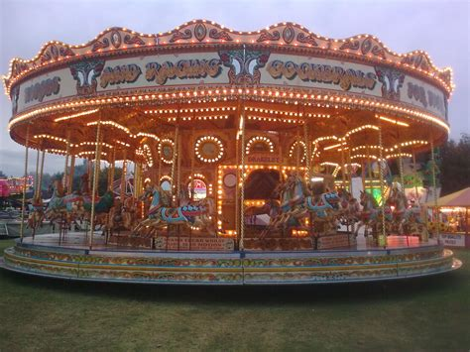


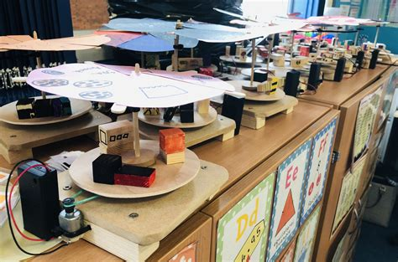

Leisure and Entertainment Knowledge Organiser Y5-6 Term 6
Links to Other Subjects
Design Technology Research and develop design criteria for a ride model. Make an electrical moving fairground ride model. Ensure that the model is functional and aesthetically appealing. Evaluate their final product against their design criteria, suggesting improvements and adaptations. Understand and use an electrical system.
Key Vocabulary
trade union
commercial
social
technological development
professional
Industry
popular music (pop)
influence
culture
broadcast
Key Knowledge
To understand that leisure and entertainment are essential for people to be healthy, as well as mentally and physically productive. To place events in chronological order using a timeline. Discuss how dancing has been an important social activity, comparing how dances have changed in the 20th century. Look at how theatres have developed during the 21st century. Understand the importance of cinema and describe the current threats to the film industry since it’s been established. Compare how television has changed since the first broadcast in 1926. Explain the development of television since the 20th century. Explore how music trends and technology have evolved over time. Compare how fashion trends have developed over the 20th century. Explain how sport became professional and why sports stars are paid large sums of money to compete.
Prior Learning | Preparing for the Future
Changes in Britain from the stone age to the Iron Age. Describe events from the past using dates when things happened. Suggest why certain events happened or people acted as they did in history. Explain how events from the past have shaped our lives today. Provide examples of how events in the past shaped people’s lives over time and have influenced how we live today. | KS3: Know and understand the history of these islands as a coherent, chronological narrative, from the earliest times to the present day: how people’s lives have shaped this nation and how Britain has influenced and been influenced by the wider world. Challenges for Britain, Europe and the wider world 1901 to the present day. Ideas, political power, industry and empire: Britain, 1745-1901

