Slide 1
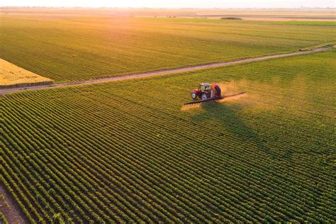


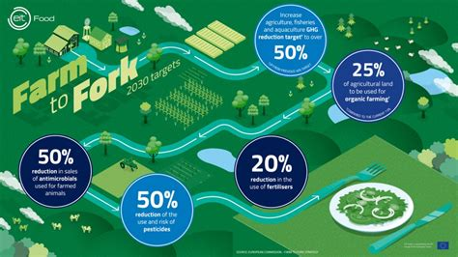

How does Climate Change Impact Farming? Y5-6 Term 5
Links to Other Subjects
Describe the changes as humans develop to old age. Identify and name the main parts of the human circulatory system, and describe the functions of the heart, blood vessels and blood Recognise the impact of diet, exercise, drugs and lifestyle on the way their bodies function Describe the ways in which nutrients and water are transported within animals, including humans.
Key Vocabulary
Arable land – Land that is fit for cultivation and used to grow crops.
Pasture land – Land used for grazing by livestock.
Traceability – The ability to trace a product back to its source.
Economic Activity – The process of producing, buying and selling goods
Land use – The function of the land.
Sustainable – Able to continue over a period of time.
Key Knowledge
To learn how farmers have diversified to survive the current climate. To explain different farming processes. To understand the different environmental factors which affect food production. To understand the link between land use and economic activity. To understand how climate change affects what is grown. Global climate change can make weather very unpredictable. This makes it harder for farmers to produce food, which affects us all. To understand and calculate food miles and where we get our food from. To explain that the further out food has come from, the chances are that more fuel was used in getting it to us – this has a negative impact on the planet (using up non-renewable fuels, pollution, costs). Discover ways to reduce our impact on the environment (eat more foods produced closer to home which has not been transported lots of times). To understand the importance of renewable energy and the importance of bio-fuels.
Prior Learning | Preparing for the Future
Y3-4: Name and locate human and physical characteristics in the countries we are studying; including land use patterns. Describe and understand key aspects of human geography – land-use | KS3: Human geography relating to: population and urbanisation; international development; economic activity in the primary, secondary, tertiary and quaternary sectors; and the use of natural resources. Understand how human and physical processes interact to influence, and change landscapes, environments and the climate; and how human activity relies on effective functioning of natural systems.

