Slide 1
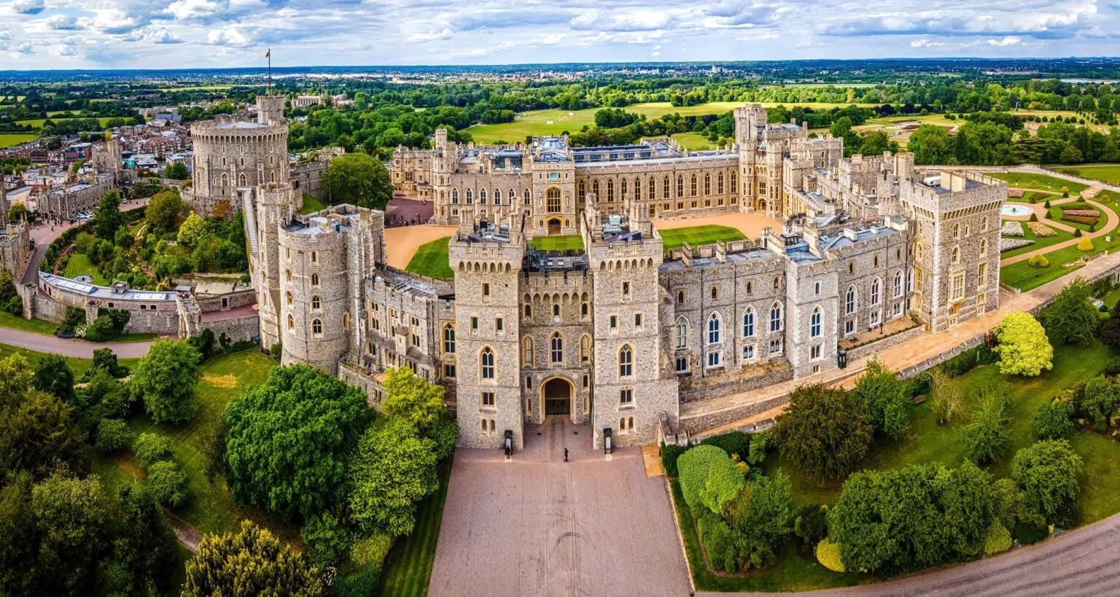



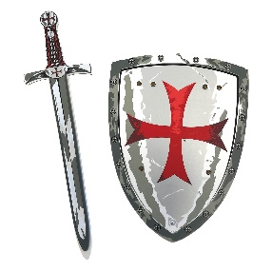
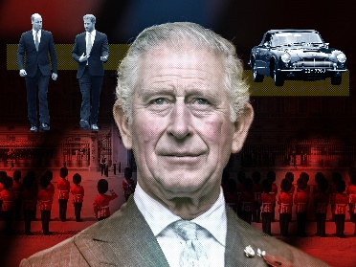
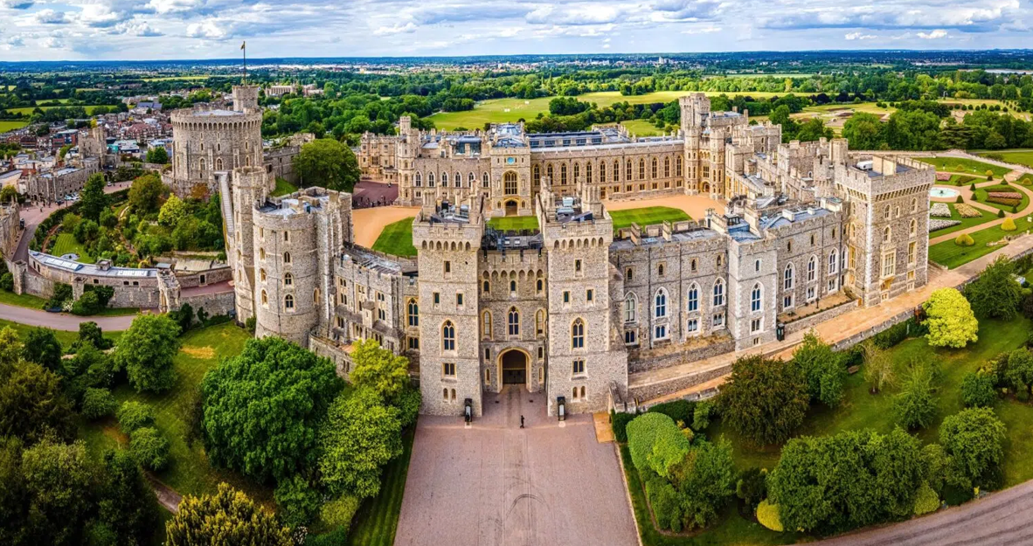
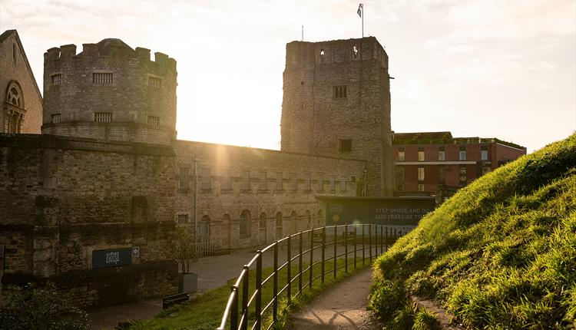
Castles and Dragons Knowledge Organiser Y1&2 Term 5
Links to Other Subjects
Geography Most castles were built on hills or higher ground with clear views of the surrounding lands – and both of these things make them difficult to attack. Oxford has a castle A human feature has been made by man and includes; towers, moats, drawbridges and arrow loop windows. A physical feature is made by nature and includes; hills, rivers, woods, forests and oceans.
Key Vocabulary
Castle A large, strong building built in the past by a ruler or important person to protect the people inside from attack
Dragon A mythical creature
King A male head of the Royal Family
Queen A female head of the Royal Family
Queen A female head of the Royal Family
Moat A deep, wide ditch surrounding a castle typically filled with water and intended to be used as a defence against attack.
Drawbridge A strong building built over the gateway to the castle.
Knight A warrior of the middle ages who fought on horse-back.
Armour A metal covering to protect the body in battle.
Portcullis A strong, heavy spiked barrier that can be lowered to block an entrance.
Turret A small tower on top of a larger tower or at the corner of a building.
Coat of Arms A unique design painted on a shield
Drawbridge A bridge that could be raised to prevent people from crossing over and going into the castle .
Key Knowledge
History A castle is where kings and queens live or lived. Most castles are made of stone. Some castles have a moat to defend them. I know some job roles of people who live in a castle. I know the design of castles changed over time and I can put them on a timeline. I know our King, Charles III lives in a castle called Windsor Castle. I know dragons are mythical figures. King Charles III is our current reigning monarch he became king on 8th September 2022 when Queen Elizabeth II died. He was Coronated on 6th May 2023. His wife Camilla is Queen. Prince William will become King if King Charles III dies.
Prior Learning | Preparing for the Future
Castles are a type of home that were built to protect the people inside. Important people normally lived in castles. A knight is somebody who has trained to fight as a soldier in battles. Knights and castles have existed for hundreds of years in Britain! | Changes in Britain from the Stone Age to the Iron Age. A local history study and the development of Oxford City Use a timeline to order events and significant people for the period of time I am studying. Name and locate places and countries we are studying; including Oxford Name and locate major cities in the countries we are studying

