Slide 1
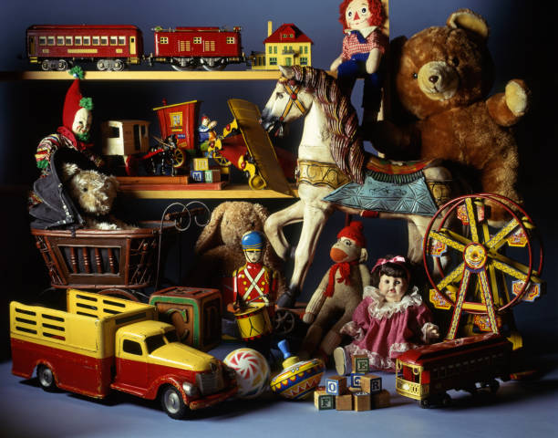



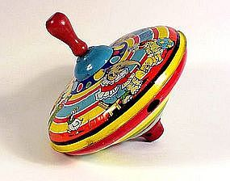

History of Toys Knowledge Organiser Y1&2 Term 4
Key Knowledge
History Know how toys have developed and changed over the years. Know how toys differ in design and material today compared to their grandparents’ time Know which toys are modern and which are old. Know what toys used to be and now are typically made from. Know that design, materials, and technology can indicate whether a toy is old or new Know some typical toys of rich and poor Victorian children Develop awareness of the past and use common words and phrases related to time e.g. past, present, then, now etc Know how to order events chronologically on a time line. Know how to use a range of sources to answer questions about the past Identify similarities and differences between ways of life at different times in the past.
Links to Other Subjects
Geography An Ordnance Survey map is used to help people find their way around an area Features of a neighbourhood. Map Symbols. How to create a map of an area. Where does our food come from? Why is it important to buy local?
Key Vocabulary
20th century Between 1900 - 1999
21st century Between 2000 – present
Materials - Wood, plastic, metal and glass are just some of the materials we make things from.
Modern Relating to the present times as opposed to the remote past.
Old Belonging to the past.
Victorian During the Victorian period.20 Jun 1837 – 22 Jan 1901
Chronology – Putting things in time order.
Era – a period of time in history. An era often begins or ends with an important event.
Generation – a group of people children, parents, grandparents.
Past – having happened or gone by at an earlier time.
Present – existing in this time.
Prior Learning | Preparing for the Future
Talk about members of their immediate family and community . Comment on images of familiar situations in the past. Compare the similarities and differences from my immediate environment. Make observations and explain why some things occur; talk about changes. | Develop a chronologically secure knowledge and understanding of British, local and world history. Look at the impact of our extreme earth on our lives through the study of photographs, population numbers and other primary sources. Draw conclusions; include diagrams and key geographical vocab. Sketch maps of human and physical features. Devise and carry out surveys of the public to inform geographical research.

