Slide 1
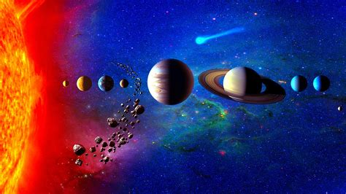


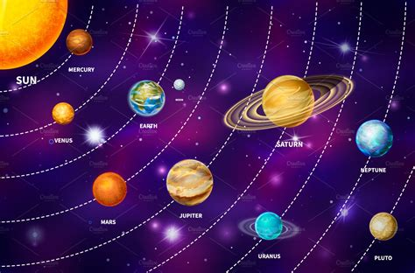
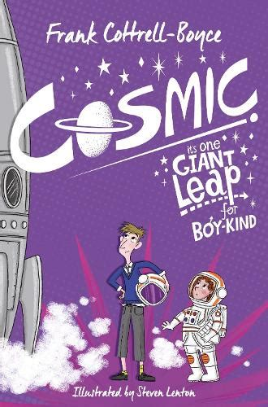
Earth and Space Knowledge Organiser Y5-6 Term 4
Links to Other Subjects
Geography: Use the terns longitude, latitude, North and South Hemisphere, Tropics of Cancer and Capricorn. Lines of latitude are parallel to the equator The lines of longitude are perpendicular to the lines of latitude. All lines of longitude run through both the North and South Poles. To understand how time zones are created, by the lines of longitude.
Key Vocabulary
Orbit – To revolve and travel in circles
Geocentric – belief that Earth is centre of universe
Heliocentric – belief that sun is centre of universe
Moon Phase - A lunar phase or Moon phase is the apparent shape of the Moon's directly sunlit portion as viewed from the Earth
Axis - Axis is a noun that means a straight line about which a geometric figure rotates
Key Knowledge
To know that: The Moon is just over 400,000 km away from the Earth. The Earth spins on its axis in an anti-clockwise manner. Because the Earth spins continuously, the sequence of day and night is cyclical. The Earth is tilted on its axis by 23.5o. The Moon moves around the Earth in an elliptical manner. The gravity of the Earth makes the Moon speed up as it gets closer, and as it moves away the Moon slows down, so the orbit is an ellipse. It takes approximately 28 days for the Moon to make one orbit of the Earth. The relative positions of the Sun, Moon and Earth dictate the size and shape of the illuminated part of the Moon. One complete phase lasts 29.53 days. The Sun makes up 99.9% of the mass of the solar system. The rings of Saturn are made of rock and ice. Without Jupiter, the Earth would be hit with more meteors. Jupiter’s gravity sweeps up many meteors, shielding the Earth. The Sun is 4.5 billion years old and will shine for another 5 billion years or so before it runs out of its fuel – hydrogen.
Prior Learning | Preparing for the Future
Y3-4: Yr. 3 – Light - Recognise that light from the sun can be dangerous and that there are ways to protect their eyes. Yr. 3 – Forces - Explain that unsupported objects fall towards the Earth because of the force of gravity acting between the Earth and the falling object. | KS3 - Space physics Gravity force, weight = mass x gravitational field strength (g), on Earth g=10 N/kg, different on other planets and stars; gravity forces between Earth and Moon, and between Earth and Sun (qualitative only) Our Sun as a star, other stars in our galaxy, other galaxies The seasons and the Earth’s tilt, day length at different times of year, in different hemispheres The light year as a unit of astronomical distance.

