Slide 1
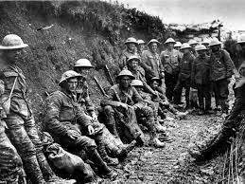


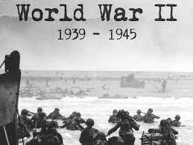

World War II Knowledge Organiser Y5-6 Term 3
Links to Other Subjects
Art: Use shading to add interesting effects to my drawings, using different grades of pencil. Use a variety of different shaped lines to indicate movement in my drawings. Use shading to show shadows and reflections on 3D shapes. To study other artists’ drawings and experiment with some of these styles - Lowry
Key Vocabulary
Air-raid - An attack by enemy planes dropping bombs.
Anderson shelter - A small shelter made from corrugated steel to protect people in air-raids.
Allies Countries - (including Britain, France, the Soviet Union and the USA) who fought the Axis Powers.
Axis Powers - Germany, Japan, Italy and other countries that fought against the Allies.
Blackout - A wartime ban on streetlights and other lights at night, to reduce the risk of bombing by enemy planes.
Blitz - A prolonged period of German air raids on Britain. From the German ‘blitzkrieg’ which means ‘lightningwar’.
Key Knowledge
To explain why WW2 began. The leader of Germany, Adolf Hitler, had plans to take over other countries. In March 1938, Germany invaded and annexed Austria, which made other countries worried. On 29th September 1938, British, French, German and Italian leaders signed a treaty called the Munich Agreement. To understand why people were evacuated. Evacuation happened in waves, beginning on 1st September 1939. Other waves occurred at the start of the Battle of Britain and at the start of the Blitz. To understand why rationing was introduced during WW2. Supply ships were targeted by German bombers and it was necessary to conserve as much food as possible. Rationing meant that each person was only allowed a fixed amount of foods. The role of women in WW2. When men were called up for active service, women were needed to do jobs such as making weapons, driving buses and trains or working in engineering or shipbuilding. Some joined the armed forces themselves.
Prior Learning | Preparing for the Future
Y3-4: Changes in Britain from Stone Age to Iron Age. Describe events from the past using dates when things happened. Use a timeline to order events and significant people for the period I am studying. Suggest why certain events happened of people acted ad they did in history. Explain how events from the past have shaped our lives today. Identify differences in accounts of history and suggest reasons for these. | KS3: Know and understand the history of these islands as a coherent, chronological narrative, from the earliest times to the present day: how people’s lives have shaped this nation and how Britain has influenced and been influenced by the wider world Challenges for Britain, Europe and the wider world 1901 to the present day

