Slide 1
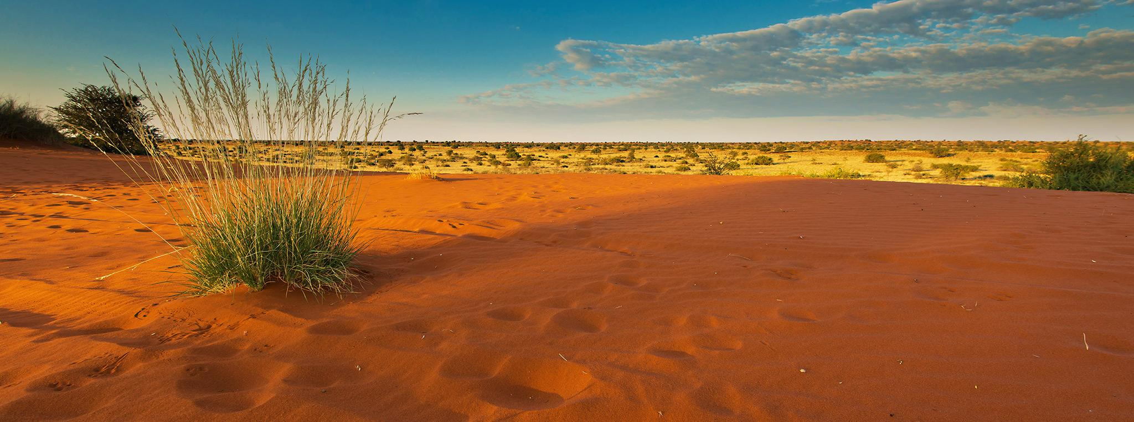


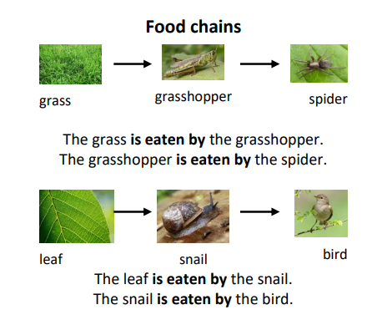
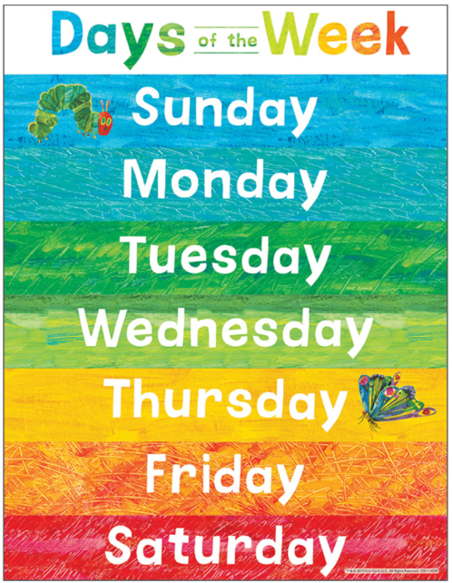
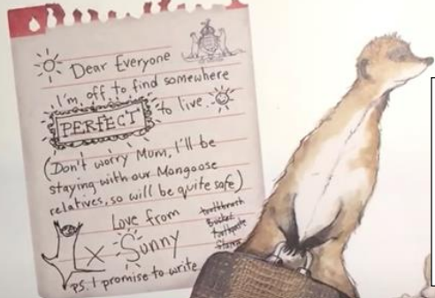
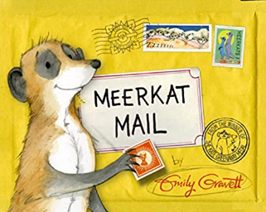
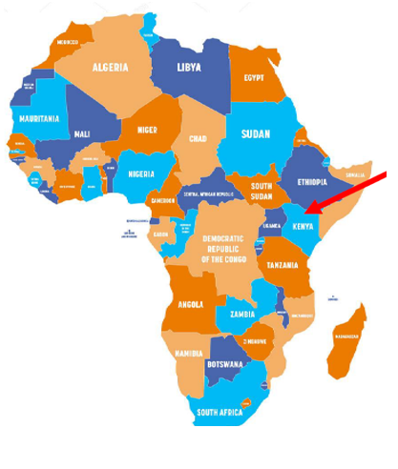


Africa/Meerkat Mail Knowledge Organiser Y1&2 Term 2
Links to Other Subjects
Science Explain a simple food chain. Describe how Meerkats get their food. Describe how living things live in habitats to which they are suited. Describe how a habitat provides the basic needs for living things.
Key Vocabulary
Continent – A large area of the world that contains many countries.
Climate – the average weather in a place, it includes temperature, cloudiness and rainfall.
Flag – a cloth that symbolises a county.
Equator – is an imaginary line around the centre of the world. It is halfway between the North Pole and the South Pole.
Safari – is a trip to observe wild animals in their natural habitat.
Meerkat – a small South African animal, with a long tail, that stands up on its back legs
Food Chain - A food chain shows how each living thing gets its food. Some animals eat plants and some animals eat other animals.
Habitat - The place where and animal or plant lives.
Key Knowledge
Geography Kenya is on the equator which means it is a hot country. It is hot all year round. They have dry and wet seasons. It is still hot even when it is a wet season! Know that the Kalahari desert is a sandy savannah in Africa. Be able to use a world map and know that the seven continents are: Asia, Africa, North America, South America, Antarctica, Europe and Australia. Be able to locate Africa and discuss it being a hot country. Recognise the Kenyan and South African flags. Locate hot and cold places in the world. Plan a trip and decide what to pack and why.
Prior Learning | Preparing for the Future
Understand simple map symbols Know different countries make up the UK and it is in Europe. Know some facts about Mammals Know the days of the week Monday, Tuesday, Wednesday, Thursday, Friday, Saturday, Sunday. Be able to Talk about features of their immediate environment. | Locate human and physical characteristics in the countries we are studying; including land-use patterns. Use maps, atlases, globes and digital/computer mapping (Google Earth) to locate the countries of Europe, including Russia. Understand geographical similarities and differences through the study of human and physical geography of regions and cities in Europe. Use maps, atlases and globes to locate countries and describe features studied. Construct and interpret a variety of food chains, identifying producers, predators and prey. Explore and use classification keys to help group, identify and name a variety of living things in their local and wider environment Recognise that environments can change and that this can sometimes pose dangers to living things.

