Slide 1
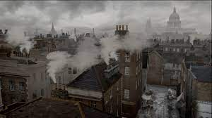


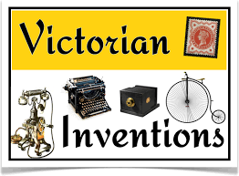
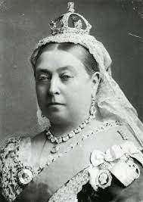
Victorians Knowledge Organiser Y5-6 Term 2
Links to Other Subjects
Design Technology: Model their ideas using prototypes and pattern pieces. Explain their choice of materials and components according to functional properties and aesthetic qualities. Accurately measure, mark out, cut and shape materials and components. Accurately apply a range of finishing techniques, including those from art and design
Key Vocabulary
Era - an important period of history Empire - a group of territories or peoples under one ruler
Monarch - a person who reigns over a kingdom or empire
Reign - the time during which a monarch rules
Census - the process by which a government counts its people Pauper - a very poor person
Rural - areas which are not towns or cities
Key Knowledge
Queen Victoria reigned over Britain and a world Empire from her coronation in 1837 to her death in 1901 – 64 years. Life in Victorian England was very different to today. It was a time of great wealth and poverty, as well as invention and scientific discovery. Children from rich and poor families lived very different lives. Working Children from poorer families had to work from a very young age to earn extra money and did not go to school. Some of the most common jobs were as trappers in coal mines, working in factories or cotton mills with dangerous machinery, selling matches or flowers on the street and chimney sweeps. The poorest (often orphans) went to the workhouse. People campaigned to make changes for poor children and laws were introduced to protect them. Victorian Education The focus was on the 3 Rs - reading, writing and arithmetic. There was a big emphasis on religion and they didn’t have PE but ‘drill’ instead. Dr Barnados set up the first orphanage to help the poor children.
Prior Learning | Preparing for the Future
Y3-4: Changes in Britain from the stone age to the Iron Age. Describe events from the past using dates when things happened. Place periods of history on a timeline showing periods of time. Say how items found in the past are helping us to build and accurate picture of how people lived in the past. Explain how events from the past have shaped our lives today. | KS3: Ideas, political power, industry and empire: Britain, 1745-1901 Challenges for Britain, Europe and the wider world 1901 to the present day Know and understand the history of these islands as a coherent, chronological narrative, from the earliest times to the present day: how people’s lives have shaped this nation and how Britain has influenced and been influenced by the wider world

