Slide 1
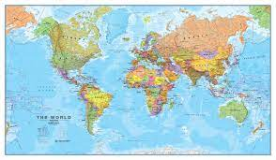


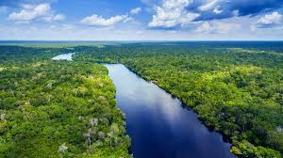
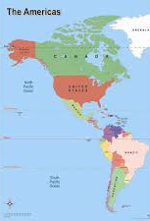
The Americas Knowledge Organiser Y5-6 Term 1
Links to Other Subjects
Science – Living things and their habitats Describe how living things are classified into broad groups according to common observable characteristics and based on similarities and differences, including micro-organisms, plants and animals. Give reasons for classifying plants and animals based on specific characteristics.
Key Vocabulary
Biomes - large geographical area which is home to certain plants and animals, specially adapted to suit the environment
Latitude - Imaginary parallel lines which circle the globe from east to west.
Longitude - Imaginary lines which run north to south across the globe from pole to pole.
Climate – the usual or average weather conditions over a long period of time.
Equator - An imaginary line around the globe at latitude 0° north dividing the earth into northern and southern hemispheres.
Key Knowledge
Use an atlas to find the names of countries and cities in America. Locate the main countries in South America and identify their environmental region. Describe the human and physical features of South America. Describe the different layers of the rainforest and how plants and animals have adapted to live there. Describe the climates and biomes of different regions across the Americas. Define Indigenous – which means the people who live there. Describe the different tribes who live in the Amazin rainforest. Understand how the Yanomami tribe live off of the forest. Understand that shabnos and their dwellings move across the forest. Explain the impact of deforestation. Know the dangers of climate change. Suggest ways in which can be more sustainable and protect our planet for the future. Name different solutions to help biodiversity.
Prior Learning | Preparing for the Future
Y3-4 Locate human and physical characteristics in countries. Use maps atlases and globes to locate countries and describe features studied. Describe and understand key aspects of physical and human geography. Sketch maps of human and physical features. Read grid references, symbols and keys | KS3: Develop contextual knowledge of the location of globally significant places – both terrestrial and marine – including their defining physical and human characteristics and how these provide a geographical context for understanding the actions of processes Understand the processes that give rise to key physical and human geographical features of the world, how these are interdependent and how they bring about spatial variation and change over time.

