Slide 1
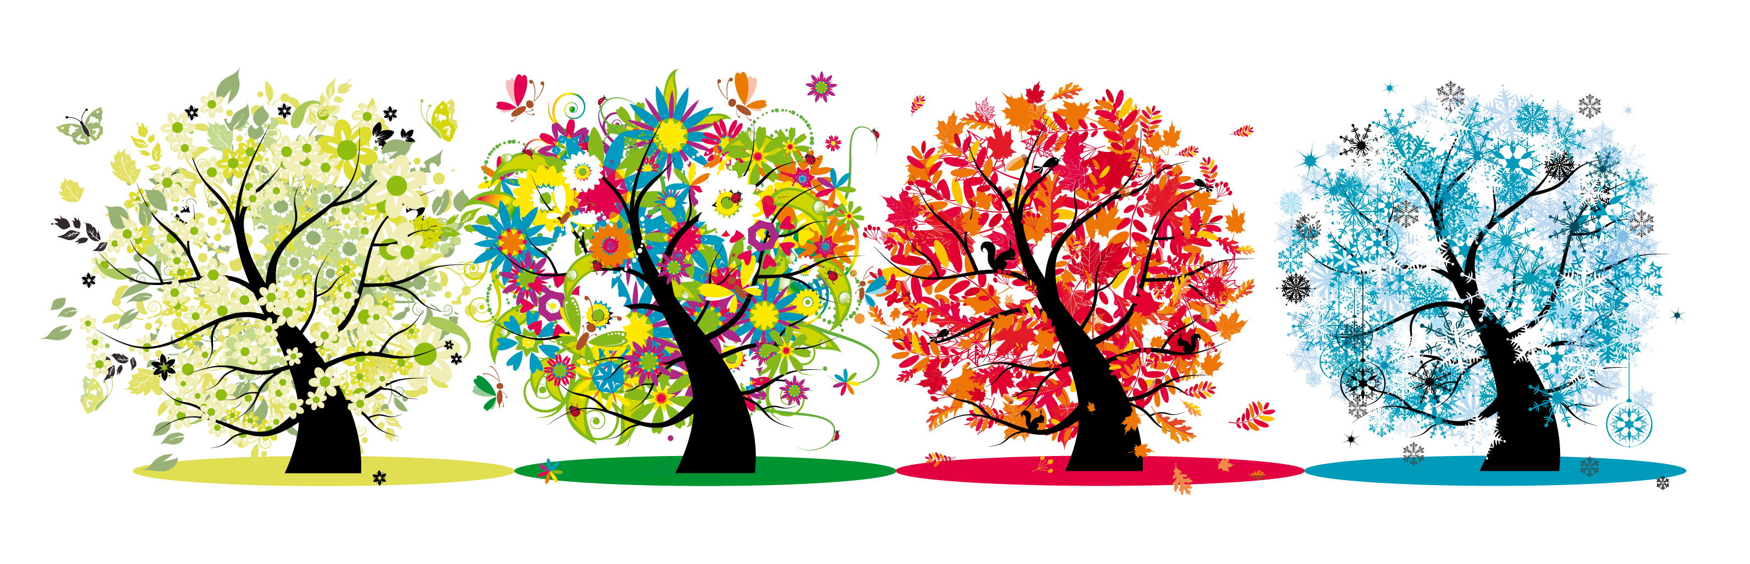


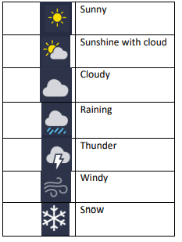
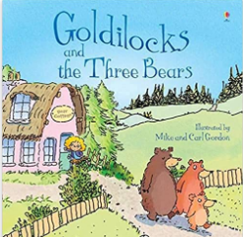

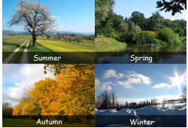
History of Homes & Seasons Organiser Y1&2 Term 1
Key Vocabulary
Modern – New or up to date.
Olden days – From a time in the past.
Artefacts – Objects from the past
Similarities – The things that are the same.
Differences – The things that are different.
Electricity – A power source used to make modern things work.
Coal – Something we burn on a fire to make heat
Scullery – A small room used for washing
Seasons – each of the four divisions of the year
Weather Forecast - a statement saying what the weather will be like.
Thermometer – a device used for measuring temperature
Temperature – a measured amount of heat in a place
Seasons (2)
Science There are 4 seasons. Spring March, April, May Summer June, July, August Autumn September, October, November Winter December, January, February The weather patterns are different in each season. A weather forecast is a statement saying what the weather will be like today, the next day or for the next few days. Weather forecasts use different symbols which are helpful.
Key Knowledge (1)
History To be able to understand what a Primary source is. To begin to describe differences using pictures and artefacts. Recognise and name different kinds of homes Describe the features of homes built a long time ago. Use terms relating to the passing of time accurately (E.G. Modern, old, a long time ago, etc.). Identify similarities and differences between modern houses and houses built a long time ago. Understand what is meant by ‘Victorian’ and that it was a long time ago. Know that most homes in Victorian times did not have electricity. Recognise some objects found in Victorian homes. Identify some differences between objects found in modern homes and Victorian homes.
Prior Learning | Preparing for the Future
Comment on images of familiar situations in the past. Compare and contrast characters from stories including figures from the past. Compare the similarities and differences from my immediate environment. Make observations and explain why some things occur; talk about changes. The country I live in is England The are different types of weather | A study over time tracing how several aspects of national history are reflected in the locality Note connections, contrasts and trends over time and develop the appropriate use of historical terms. observe and describe seasonal changes, including weather patterns and day length variations and how these changes affect living things, like plants shedding leaves in autumn and flowers blooming in spring.

